Slide 1
Web page
포트폴리오
최재용

Slide 2
Index
Page Element
Intro Page
Main Page
Nav Page
Sub Page
Mark up test result

Slide 3






Page element
Font
Color
#000000
#1d1d1b
Html5
#666666
Css
#cdc6be
Js
#ff0000

Slide 4


Intro page

Slide 5

Main page.0

Slide 6

Main page.1

Slide 7

Main page.2

Slide 8
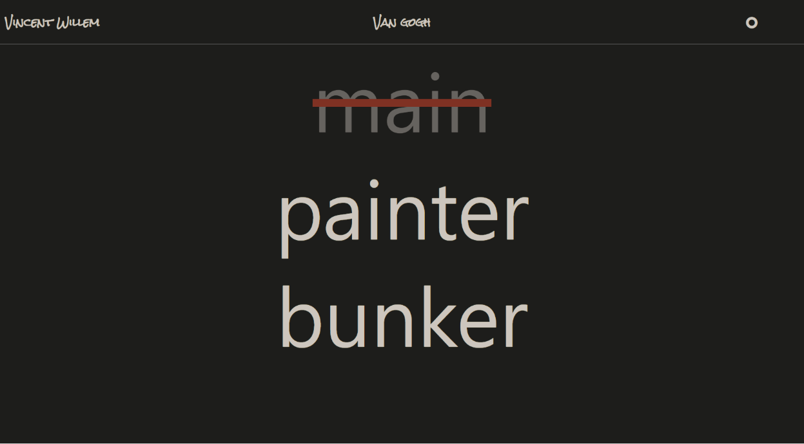
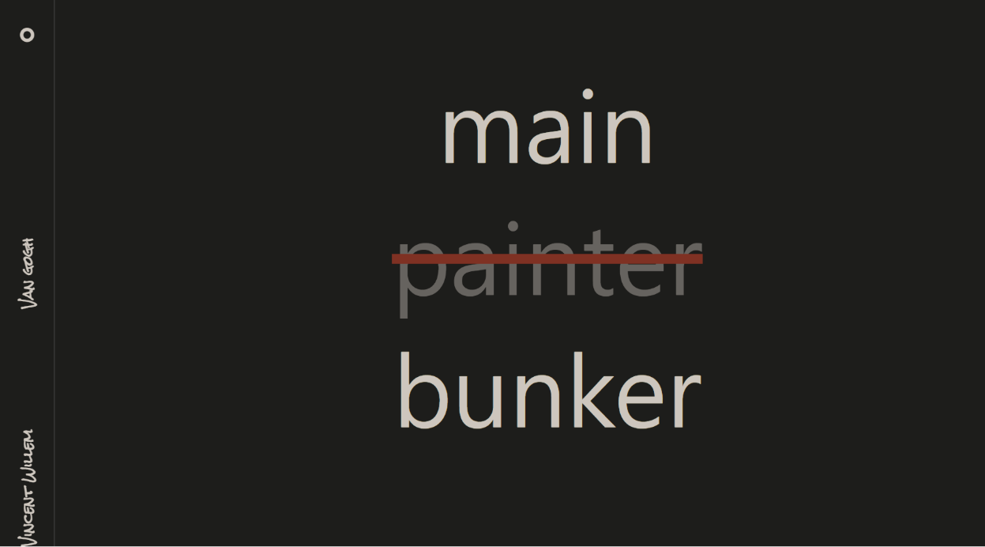
Nav page.0

Slide 9
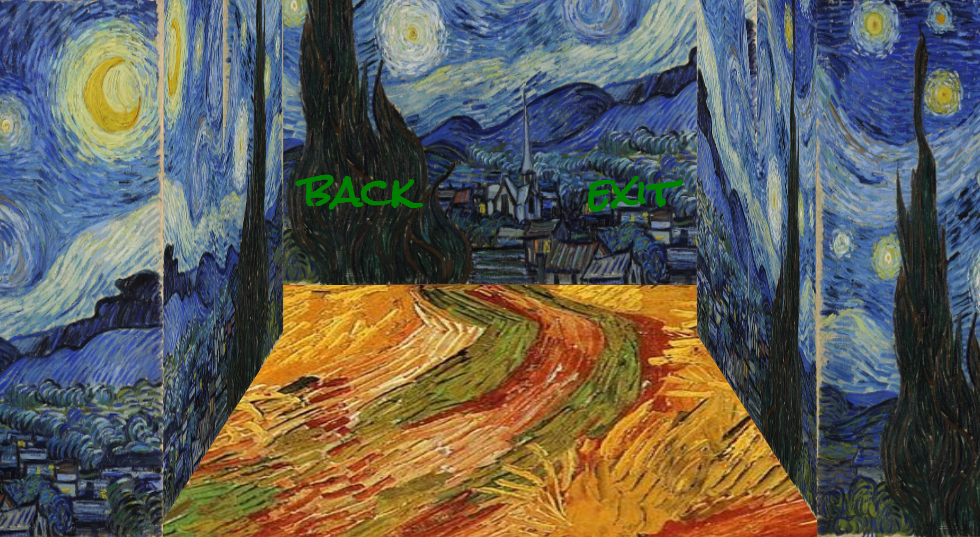
Sub page.0

Slide 10
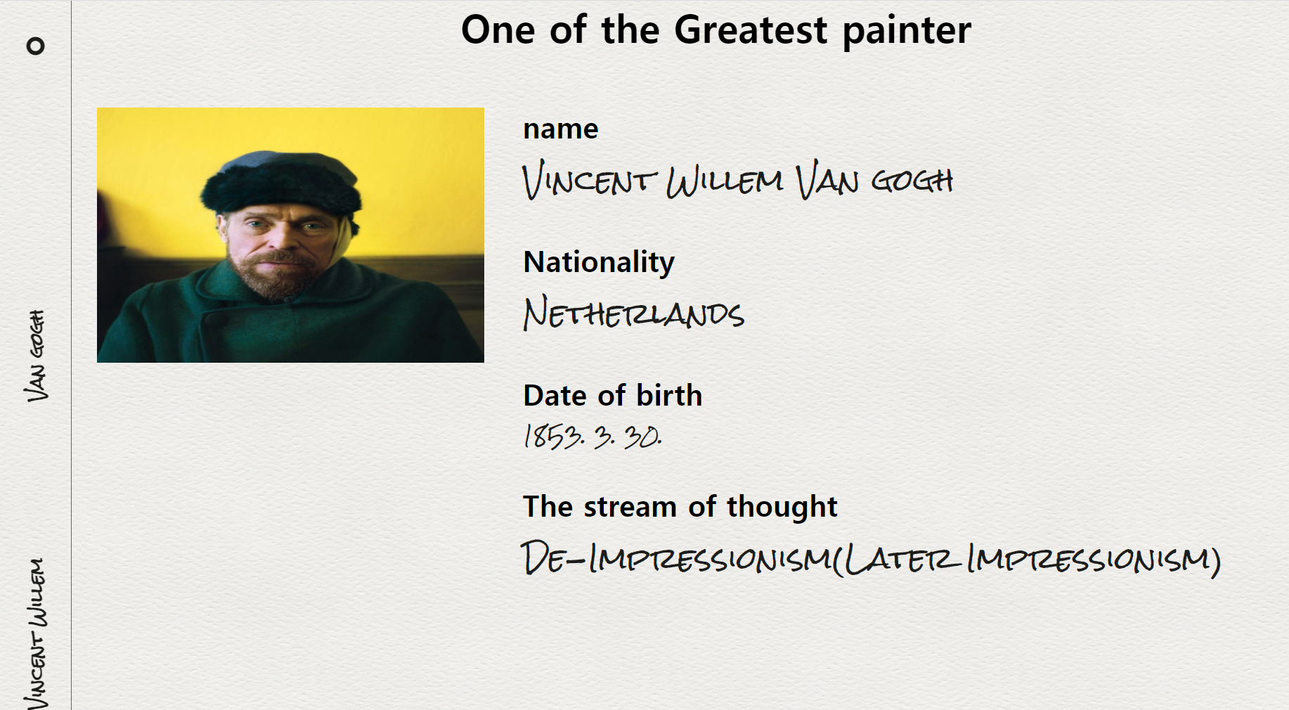
Sub page.1

Slide 11
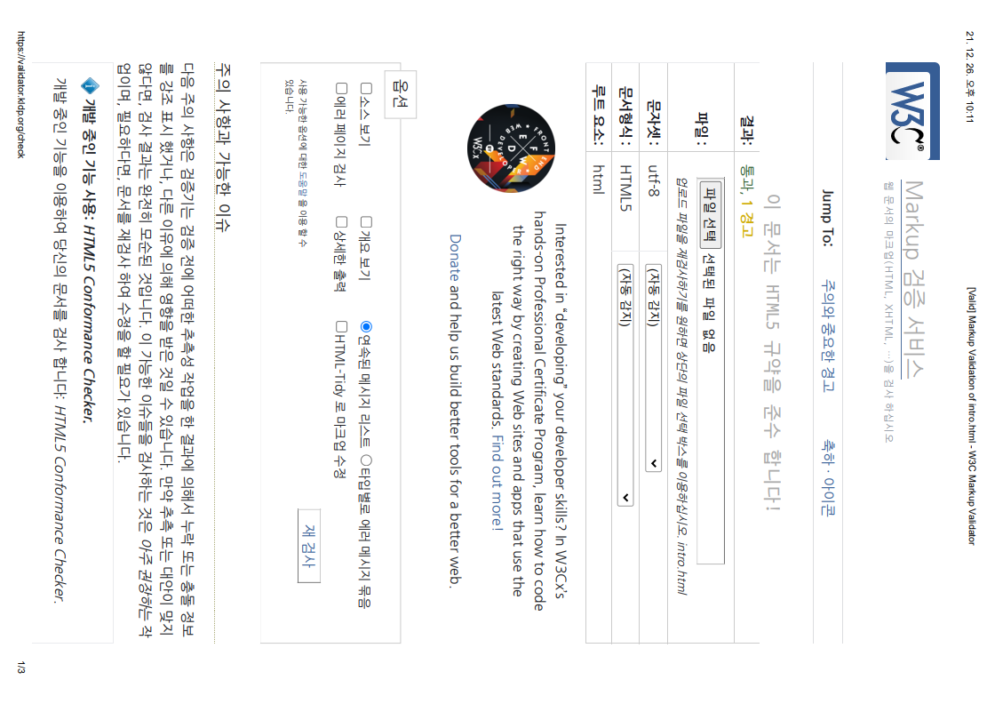
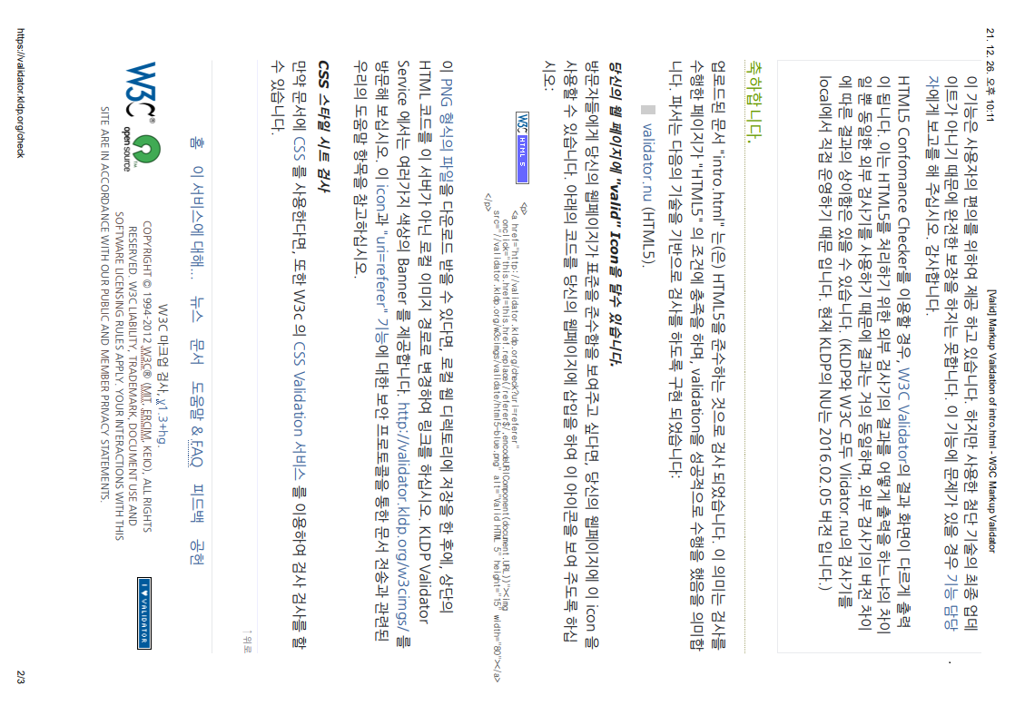
intro.html

Slide 12
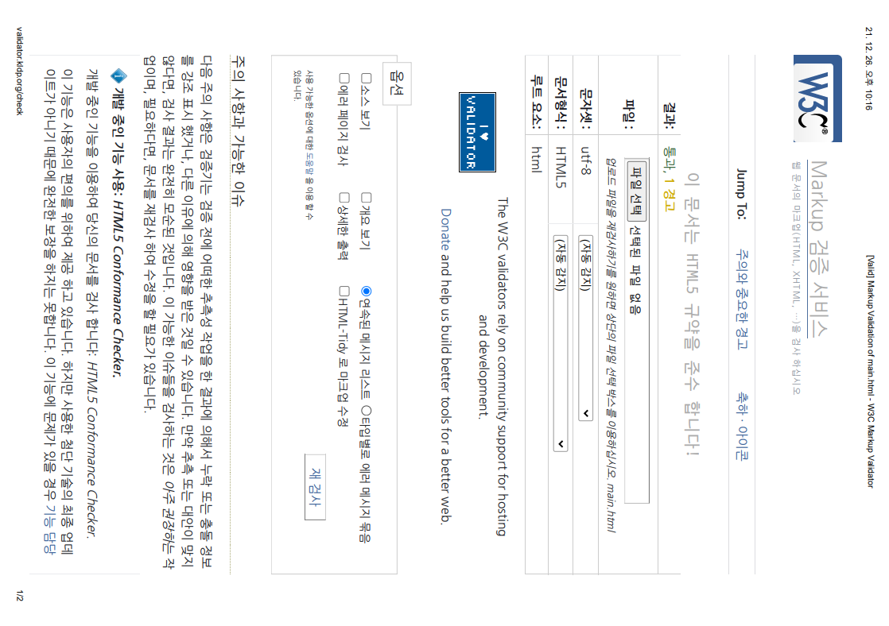
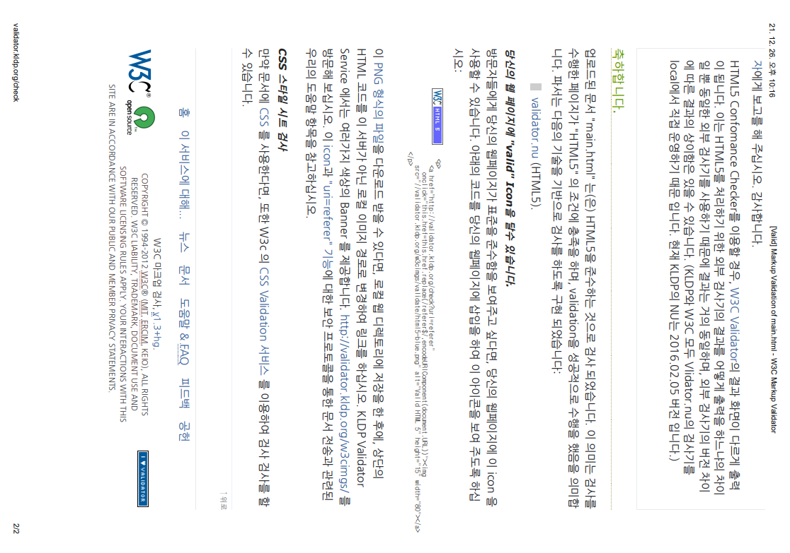
main.html

Slide 13
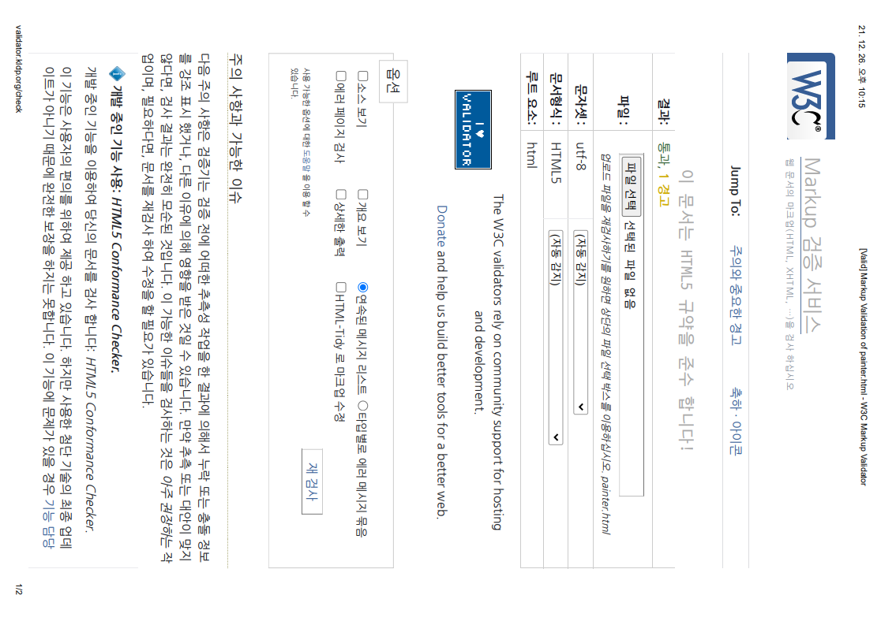
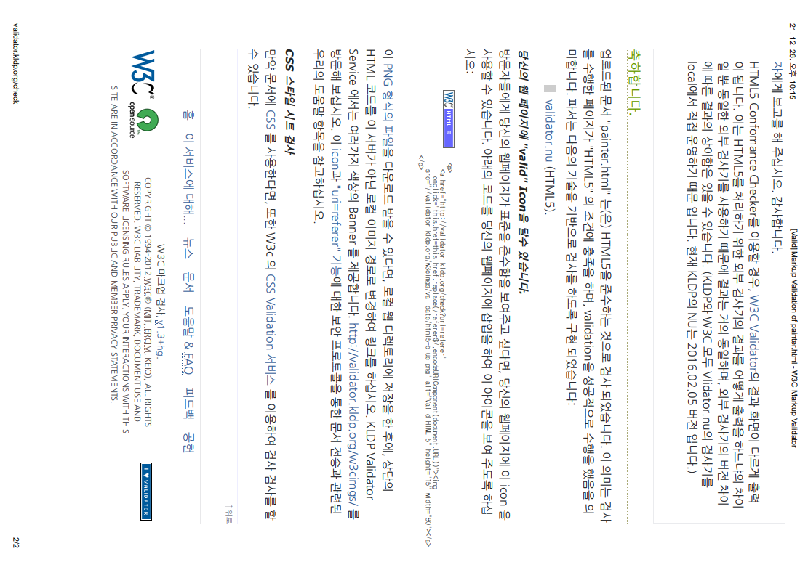
painter.html

Slide 14
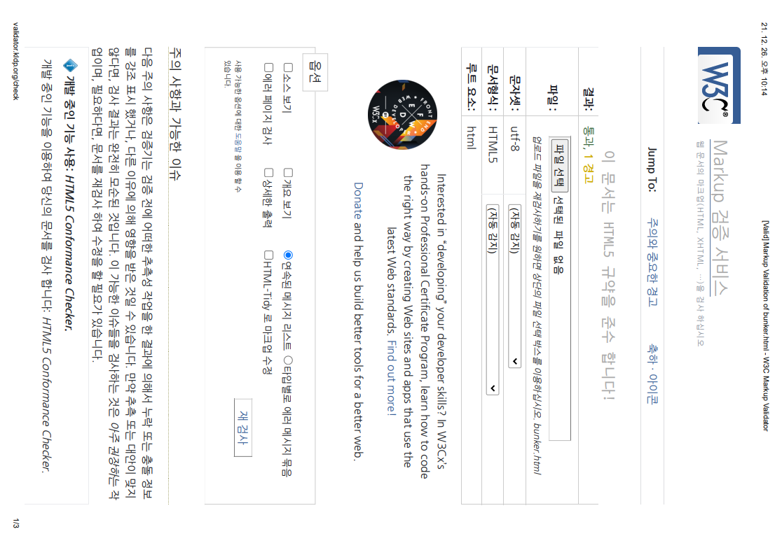
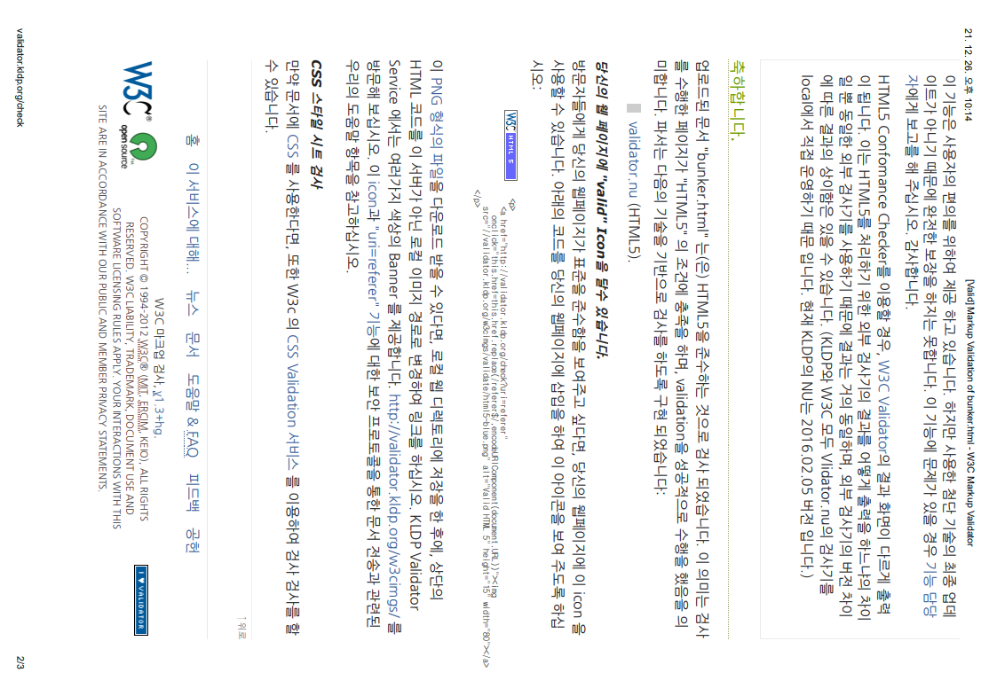
bunker.html

